Slide 1
Helping Others Find Our Data: The Development and Improvement of an IR Data Workshop
Michele Hansen, Steven Graunke, Robbie Janik
Institutional Research and Decision Support
IUPUI

Slide 2
Overarching Philosophy

Slide 3
Our Vision/Mission
We provide timely, accurate, and actionable information to support decision making at IUPUI. Decision makers have the information necessary to achieve maximum effectiveness in regard to IUPUI’s Strategic vision, mission, values, and goals related to the success and learning of our students as well as overall institutional effectiveness. Our vision is to be a nationally recognized leader in institutional research and decision support in higher education.
Notes:
Michele

Slide 4
Statement of Aspirational Practice For Institutional Research – Association of Institutional Research (AIR)
Statement of Aspirational Practice
Student Focus
Expanded Definition of Decision Makers
Structures and Leadership for IR
Leadership for IR Function
IUPUI Selected as 1 of 10 Founding Institutions
Notes:
Michele

Slide 5
IRDS Activities and Reports to Support Decision Making
Institutional Research
(Retention and Graduation Rates)
Strategic Enrollment
Management
Assessment of Student Learning and Development
Survey Research Methods
Institutional and Strategic Planning Decision Support
Program Evaluation and Program Review
(assessing what works and what needs improvement)
Notes:
Michele

Slide 6
IRDS Key Practices and Strategies to Build and Support Decision Making
Engage in efforts to understand the anatomy of decision making across campus (who makes decisions, when, how, and what data is needed).
Building data literacy, evaluation, and assessment capacity across IUPUI so that information exploration, interpretation, and analysis are used to support evidence-based decision making and improve institutional effectiveness.
Provide consultation on decision support approaches, data visualization, dashboard creation, assessment of student learning, program evaluation, survey research methods, and advanced statistical analysis procedures.
Deliver training and data tools that allow decision makers to leverage data and information.
Notes:
Michele

Slide 7
Building a Capacity for Decision Making
Data infrastructure
Relationship building
Access to decision makers
Building capacity for others (outside of IR) to collect data appropriately
Technology that allows for decision makers to have access to data
Ongoing training and support

Slide 8
Becoming Good Data Narrators and Making Connections

Slide 9
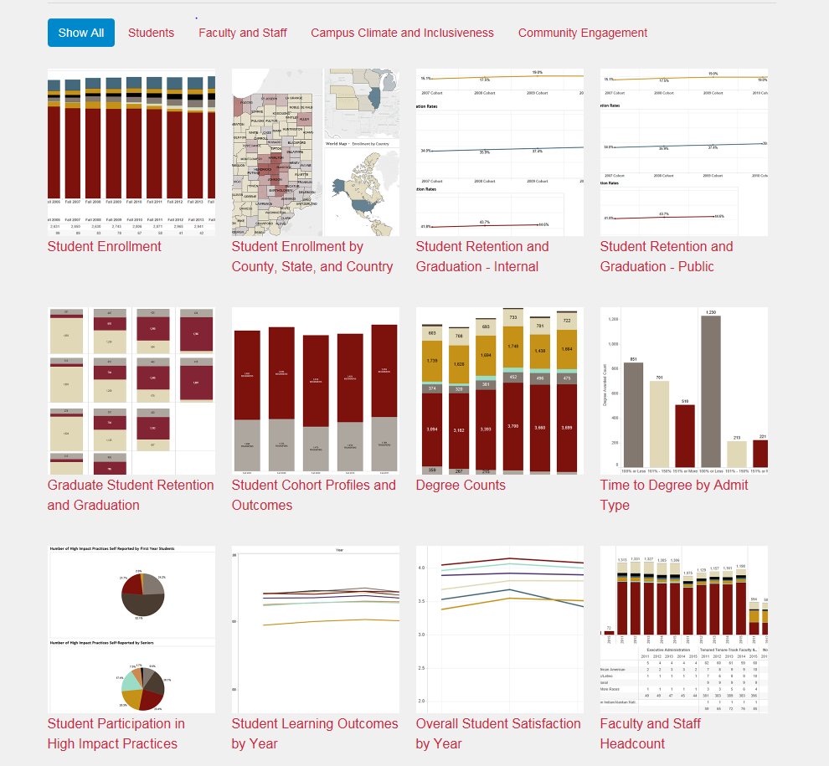
Newly Designed Website
Institutional Research and Decision Support
https://irds.iupui.edu/
Contains highly interactive dashboards allow users to drill down and filter to allow detailed exploration of key indicators associated with the IUPUI Strategic Plan.
.

Slide 10
Workshop Development

Slide 11
Development of Session
Goals
Steer faculty, staff, and students towards appropriate data resources
Improve data literacy on campus
Provide Tableau tips and tricks
Report developers presented their work
Center for Teaching and Learning
Great response – Scheduled 3 sessions

Slide 12
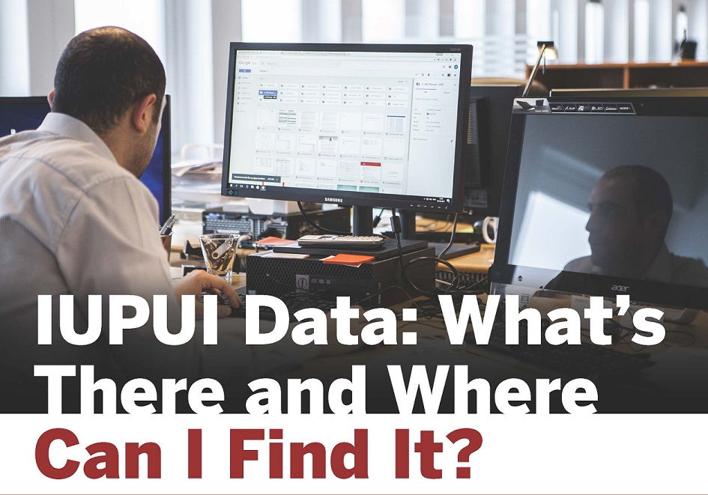
IRDS Data Workshops

Slide 13
Quick Demonstration

Slide 14
Quick demonstration
DFWI Reports

Slide 15
Quick demonstration
Graduate Student Retention and Graduation

Slide 16
Quick demonstration
Climate Survey Results Dashboard

Slide 17
Feedback and Survey Results

Slide 18
Feedback & Results
Attendees
83% staff, 16% faculty, 1% student
Ways use data
76% gather information to give to others
57% to make departmental/program level decisions
51% gather info for evaluation/assessment
23% gather info for accreditation purposes
29% School level decisions
14% University/Campus level decisions

Slide 19
Feedback & Results
Overall thoughts on workshop
84% strongly agree/agree workshop was at right level for understanding
86% agree they learned about info they did not know was available to them
88% felt more confident accessing data at IUPUI
Interest in a departmental data workshop
29% very interested and 35% somewhat interested
57% to make departmental/program level decisions

Slide 20
Feedback & Results
Most useful aspect of workshop?
“Watching the presenters navigate through the different reports”
“Learning about the sheer breadth and depth of the information available from IRDS, and how user friendly the dashboards, filters, and functions are”
How to improve workshop?
“Break into faculty based data and student programming/success based data. Then you could attend both, but could pick the one most relevant.”
“More real-world applicability is nice with any data discussion.”
“Navigation was difficult to keep up with”
“Shorter, topic driven workshops” “More specific, in-depth workshops”

Slide 21
Next Steps and Discussion

Slide 22
Next Steps
Generally positive feedback
Specific topic sessions
Financial Aid (April 5)
Additional Topics
Faculty/Staff Data
Surveys
Enrollment
Outcomes
Anything else?
Working directly with those that want to know.

Slide 23
Discussion
Have you tried to conduct similar sessions?
What worked and what didn’t?
What have you done to “get the word out” about data?
What suggestions do you have?

